Slide 1
Biblical Interpretation
Monday Evening
Defining an
“Apostolic Hermeneutic”
By David S. Norris © 2005

Slide 2

What do we believe about the Bible?
By David S. Norris © 2005

Slide 3
We believe in…
…the “verbal plenary inspiration of Scripture in the original autographs”
See II Timothy 3:16: “All scripture is given by inspiration of God, and is profitable for doctrine, for reproof, for correction, for instruction in righteousness.”
By David S. Norris © 2005

Slide 4

“All Scripture” (Greek passe graphe)
That is, “Scripture in its every part”
Verbal—every single
word (not merely
the concepts)
Plenary—all the of the Bible—the whole canon
By David S. Norris © 2005

Slide 5
“…is given by inspiration of God”
Greek: “theopneustos”, that is, “God-breathed
NIV: “All Scripture is God-breathed”
We believe it is even important whether a word is singular or plural; for example Galatians 3:16
Galatians 3:16 Now to Abraham and his seed were the promises made. He saith not, And to seeds, as of many; but as of one, And to thy seed, which is Christ.
By David S. Norris © 2005

Slide 6
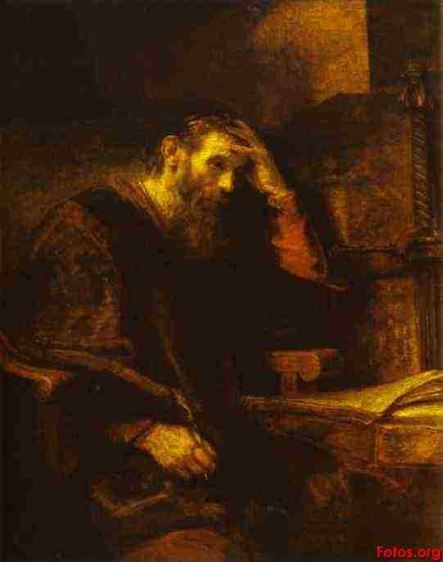
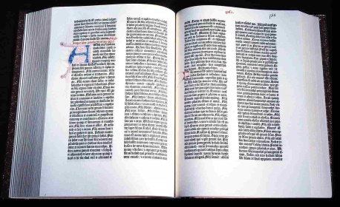

We believe in the verbal plenary
inspiration of
Scriptures in the original autographs
We do not believe in the
necessary inspiration
of the King James Version,
or any translation, for
that matter
However, we do believe
that we possess in our hands
a trustworthy text.
By David S. Norris © 2005

Slide 7
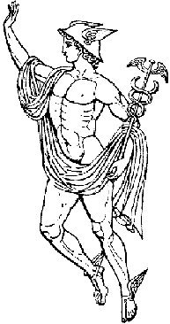
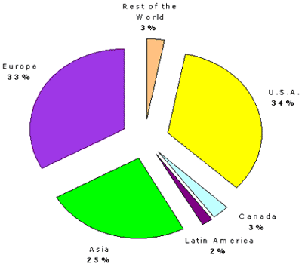
Definitions:
HERMENEUTICS: The science (principles) and art (task) by which the meaning of the biblical text is determined.
Etymologically from Hermes
EXEGESIS: The determination of the meaning
of the biblical text in its historical and literary contexts.
Etymologically from “extracting out”

Slide 8

Every level of instruction needs to
be hermeneutically sound

Slide 9
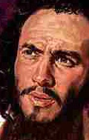
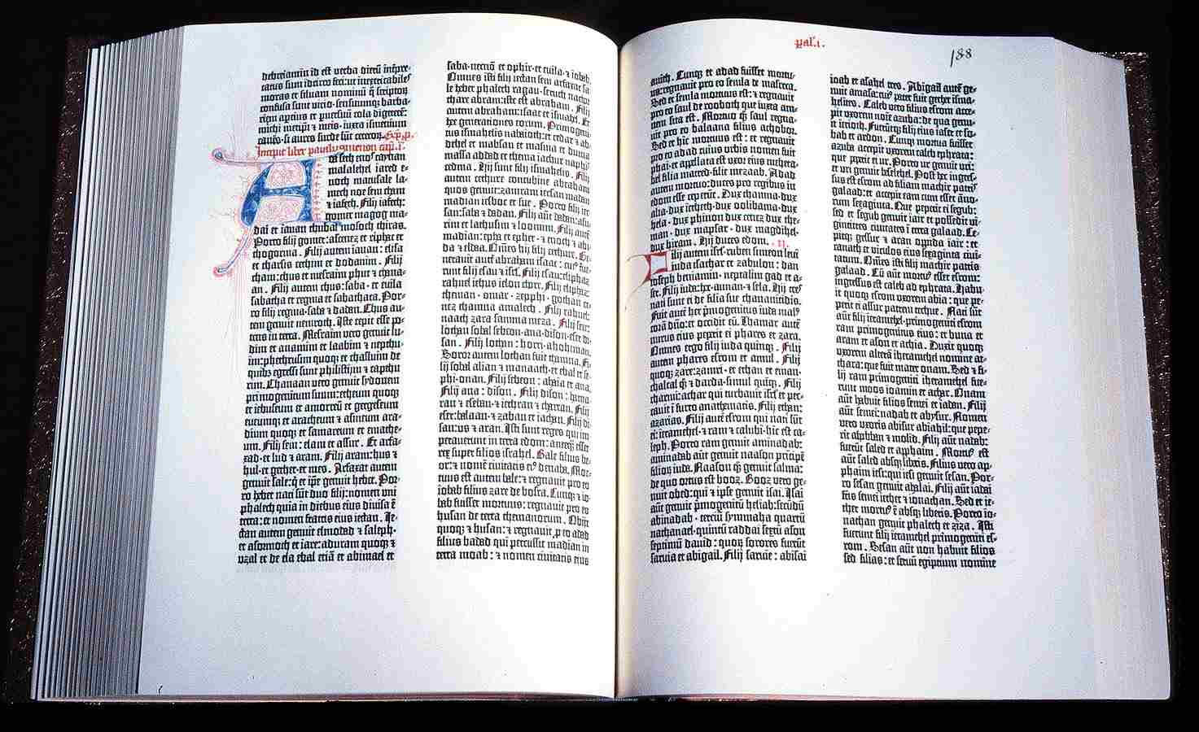
Communicating Meaning from
a Biblical Text:
Author
Text
Seeking for authorial intent,
a modernist enterprise, an
Apostolic enterprise as well
Seeking to find the original
meaning through critically
analyzing the text in the
original language

Slide 10
While the Bible is the Word of
God, the text is neither magical nor
mystical—we should reject:
Paralellomania
Structuralism
Secret Bible Codes
Hyper-typology

Slide 11


Communicating Meaning from
a Biblical Text:
Author
Text
Reading

Slide 12
Element 3: The Reader
Text
Reading
The Epistemological Question:
How will a reader’s situatedness control interpretation?
Modernity—one must find the “objective truth”
Postmodernity—not only may it not be overcome; it should
be celebrated. The truth is someplace in-between

Slide 13

Element 4: Communicating to others
Author
Text
Reading
Expounding

Slide 14
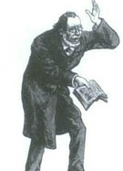


Definitions:
EXPOSITION: The communication of the meaning of the text along with its relevance to present-day hearers
HOMILETICS: The science (principles) and art (task) by which the meaning and relevance of the biblical text are communicated in a preaching situation
PEDAGOGY: The science (principles) and art (task) by which the meaning and relevance of the biblical text are communicated in a teaching situation

Slide 15


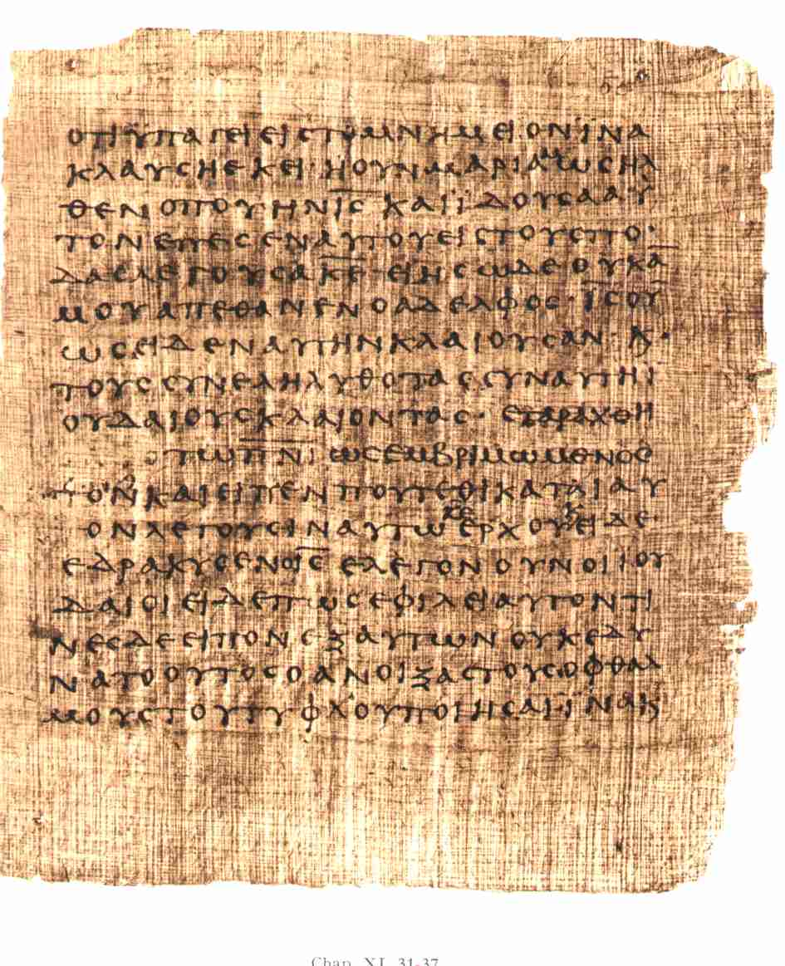
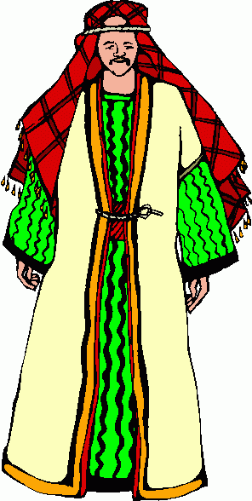
Difficulties in interpreting the Text:
Distance in Time
Distance in Language
Distance in Space
Distance in Culture

Slide 16

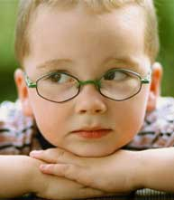
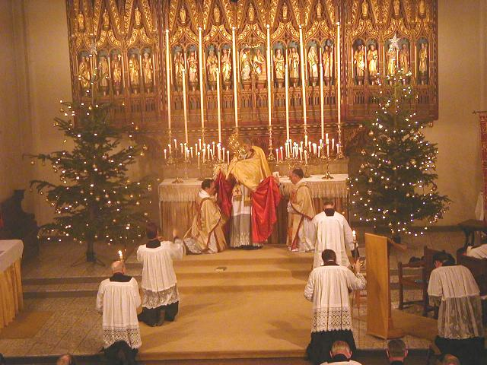

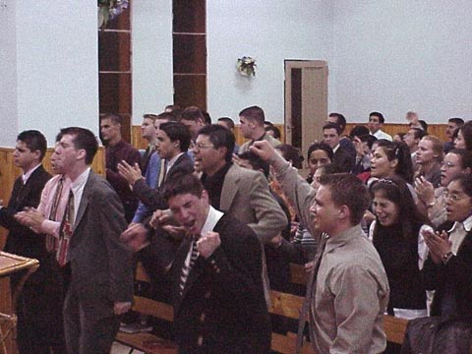

We tend to see the Scripture through the lens of our culture

Slide 17
Not only we are situated, but the authors of our
readings are situated as well
Walter Kaiser and Moisés Silva
An Introduction to Biblical Hermeneutics
D. A. Carson, Exegetical Fallacies

Slide 18

There are different genres of Scripture. Each should weighed in normative sense:
Epistles
History
Poetry
Apocalyptic
Narrative
Gospels
The Scripture is not mystical. It is meant
to be understood
That said, some texts are very difficult!
By David S. Norris © 2005

Slide 19
Hermeneutics and a "hermeneutic"
While Hermeneutics is “the art or science of interpreting Scripture”…
…one may as well speak of a “Christian hermeneutic” or a “Catholic Hermeneutic”, etc.
Such a hermeneutic suggests a common set of understandings, a common way to understand Scripture
By David S. Norris © 2005

Slide 20

Jesus Christ as
the central figure
A belief in the Bible
Morality
Christian Hermeneutic
Christianity:
2,239, 000, 000
Hinduism:
1 billion
Catholics
1,100,000,00
Protestants
720,000,000+
Emphasis on the New Testamant
Orthodox
700, 000,000+
Other
belonging to church
Islam:
1,600, 000,000
Buddhism
500 million

Slide 21
Christianity
By David S. Norris © 2005

Slide 22
Christianity
Catholics:
4 sources
of
final appeal
Bible
Tradition
Councils
Pope
One
final source
appeal:
Sola Scriptura
Protestantism
By David S. Norris © 2005

Slide 23
Christianity
Protestantism
By David S. Norris © 2005

Slide 24
Protestants
Deny the authority of the pope and
most church councils
Insist that a person is not justified
by works but by faith in Jesus Christ
Do not believe that salvation is given
by the church. Salvation comes
through the work of Jesus Christ.
Allow for tradition but rest
upon the Bible
By David S. Norris © 2005

Slide 25
Christianity
Protestantism
Evangelicals

Slide 26
Evangelicals
Hold to a high view of the biblical text
Believe in personal conversion experience
Believe that church tradition is not the final source
of appeal—the biblical text is!
Emphasize the deity of Christ, the virgin birth
and the community of believers
Believe in the second coming
of Jesus Christ
By David S. Norris © 2005

Slide 27
Christianity
Protestantism
Evangelicals
Pentecostals-
Charismatics
585 Million
By David S. Norris © 2005

Slide 28
d
Pentecostals
Believe in the power of the Spirit
Are more optimistic about
human nature and the power
of prayer
Understand the doctrinal
importance of narrative
By David S. Norris © 2005

Slide 29
Christianity
Protestantism
Evangelicalism
Apostolics
Pentecostalism
By David S. Norris © 2005

Slide 30
Apostolics:
Truly believe Sola Scriptura
Speak of conversion covenantally rather than forensically—justification speaks of the new birth
Resonate soteriologically more with a sacra-mental approach of Lutherans and Catholics than the Evangelical approach of other Pentecostals
Disregard 1700 years of Church history to
teach Christology and soteriology
like the apostles taught it
By David S. Norris © 2005

Slide 31
An Apostolic Hermeneutic:
…takes seriously OT teaching
…centers on the teaching of the Apostles
…considers as important the teaching what has been handed down to us since 1900.
If a choice must be made, Apostolics will choose the teaching of the apostles over the teaching of the historic Christian Church
Such a tradition, however, must be secondary to the teaching of the apostles
By David S. Norris © 2005

Slide 32
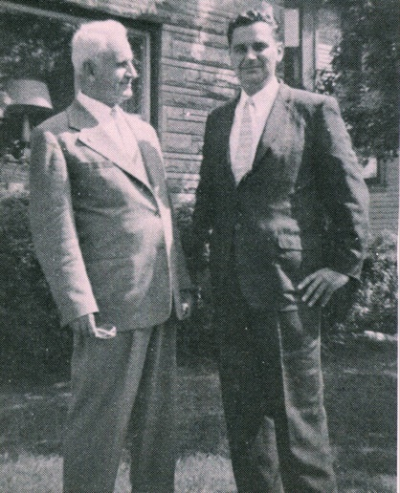
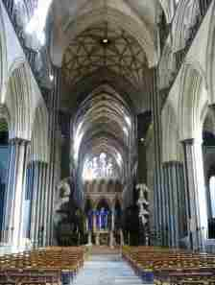
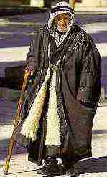
What does it mean to be Apostolic?
1. An Apostolic
Hermeneutic
starts with
the OT
3. Doctrinal
“development”
is irrelevant
The teaching
of the apostles
is primary
4. 1900-present
Restoration
of Apostolic
Truth
By David S. Norris © 2005

